Slide 1

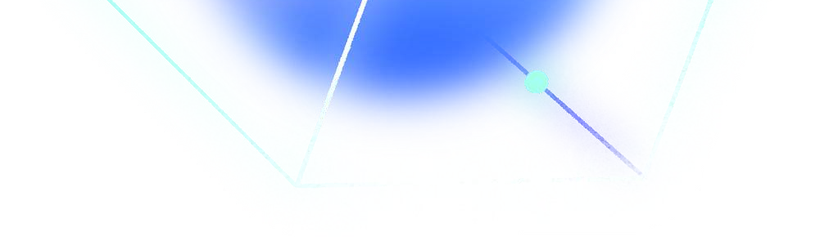

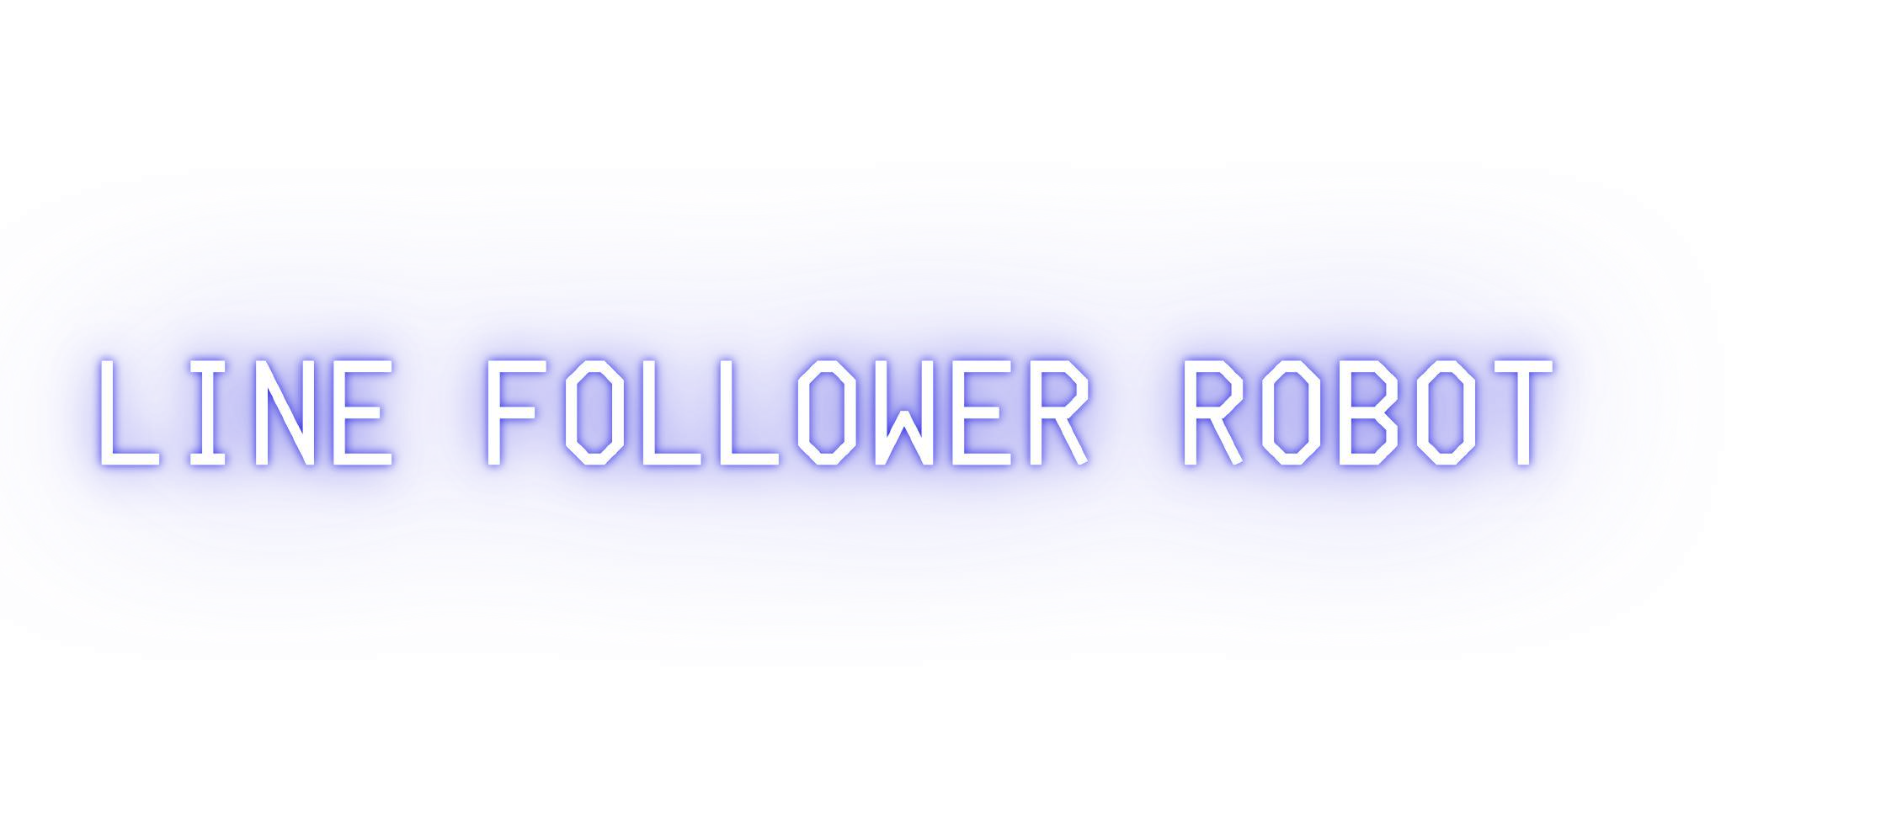
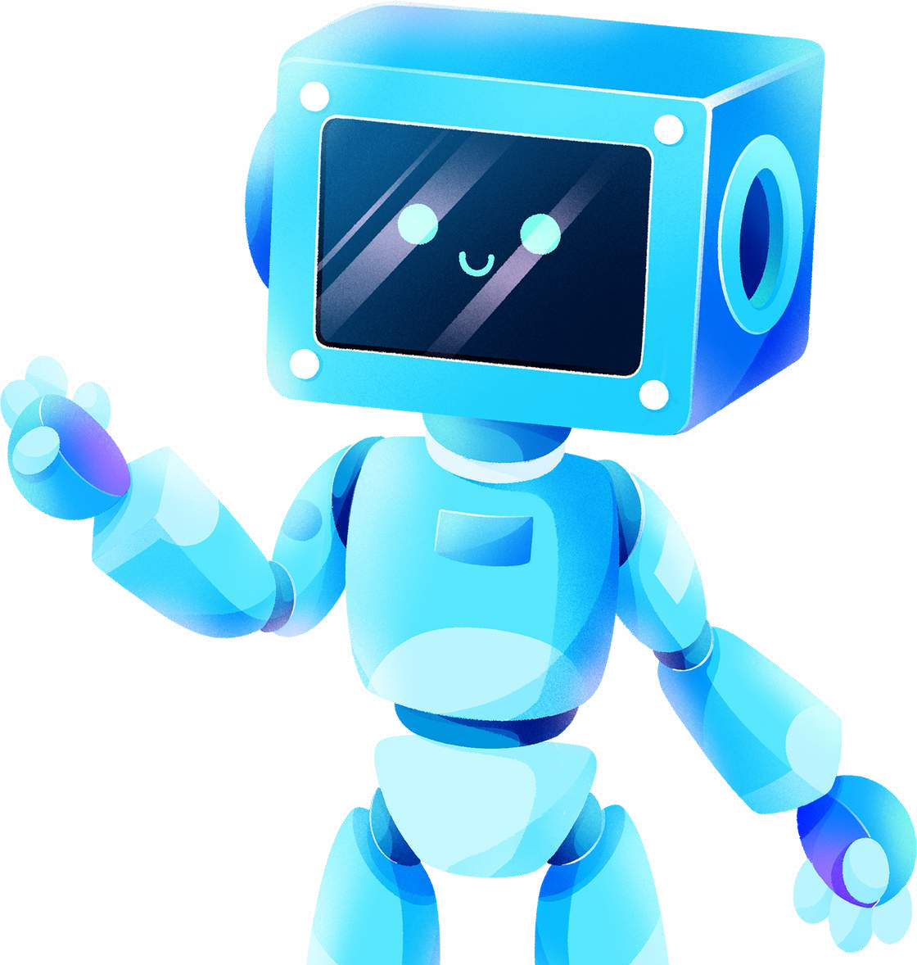
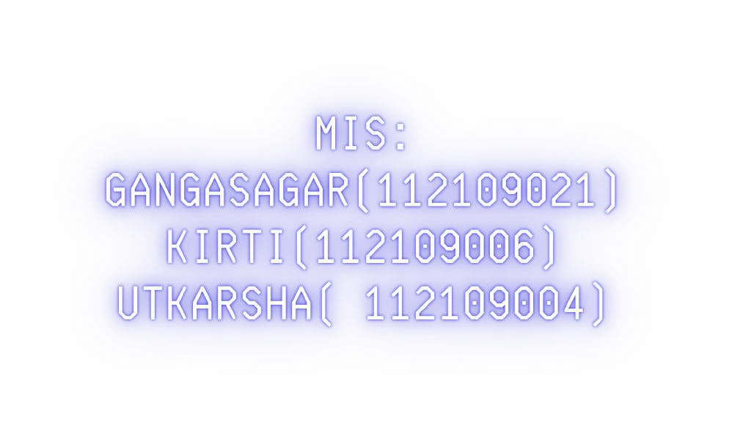

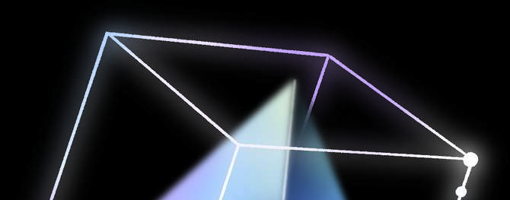

Slide 2



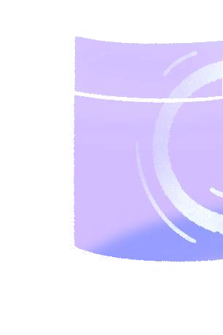



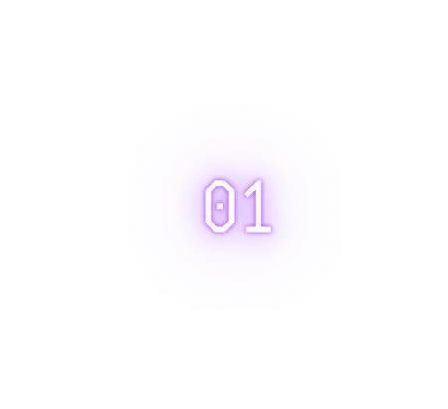
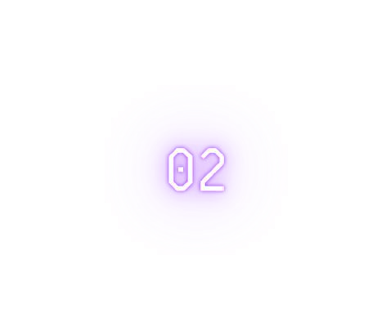
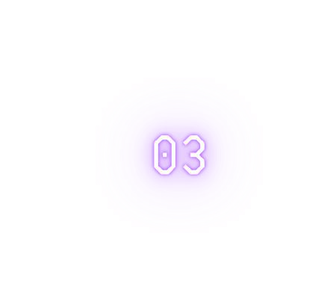
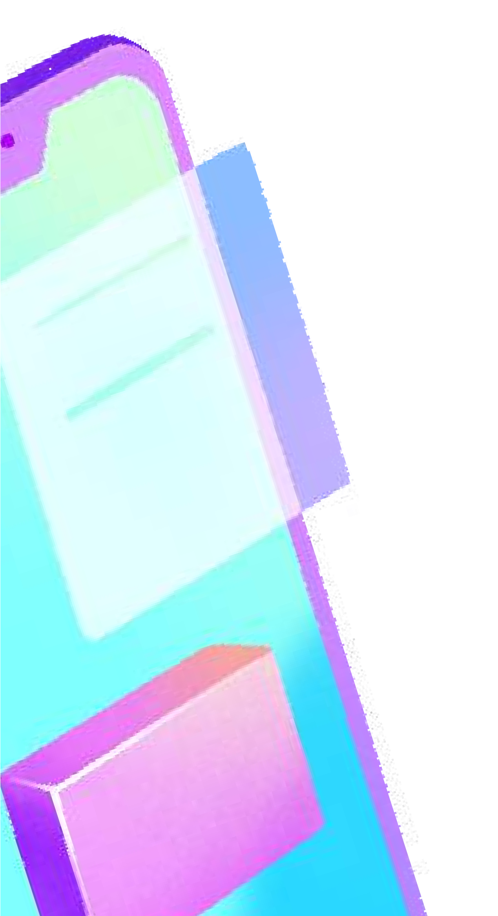

A line follower robot car is a car that follows a visual line, which is usually white or black, .
The robot continues this process of adjusting its direction based on the sensor readings from the IR sensors, allowing it to follow the line
The robot moves forward until one of the side sensors (left or right) detects the line. When the line is detected, the robot turns in that direction.

Slide 3
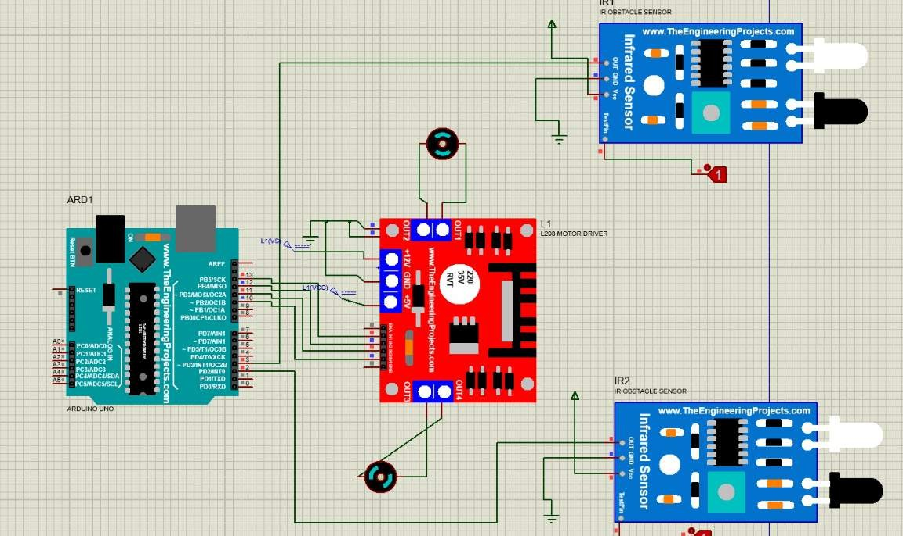

Slide 4

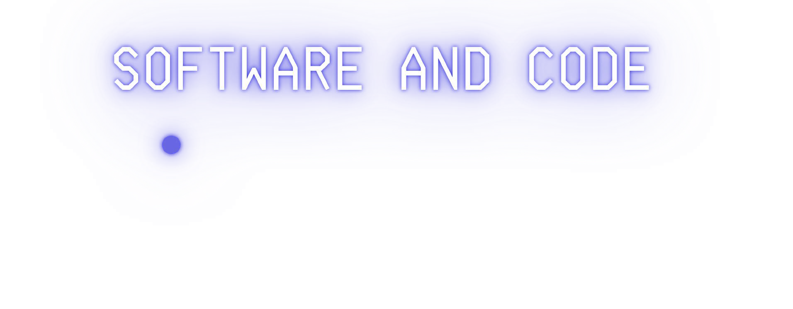




Library Inclusion: You include the AFMotor library, which allows you to control the four DC motors on your robot using the Adafruit Motor Shield.
Pin Definitions: You define the pins for your two IR sensors (left and right). These pins A0,A1 will read the input from your IR sensors.
Motor Definitions: You define four motors (motor1, motor2, motor3, and motor4) using the AF_DCMotor class. These motors are associated with specific motor ports on the motor shield.
Setup Function:
You set the sensor pins (left and right) as INPUT.
You start serial communication at a baud rate of 9600 to print sensor values to the serial monitor.
Loop Function:
Inside the loop function, you continuously read the values from your IR sensors and act on them.
Sensor Readings:
You read the values from the left and right sensors and print them to the serial monitor. These readings will be either 0 (black detected) or 1 (white detected).

Slide 5
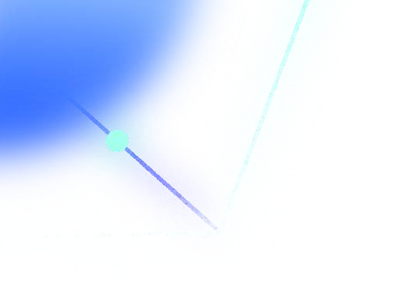
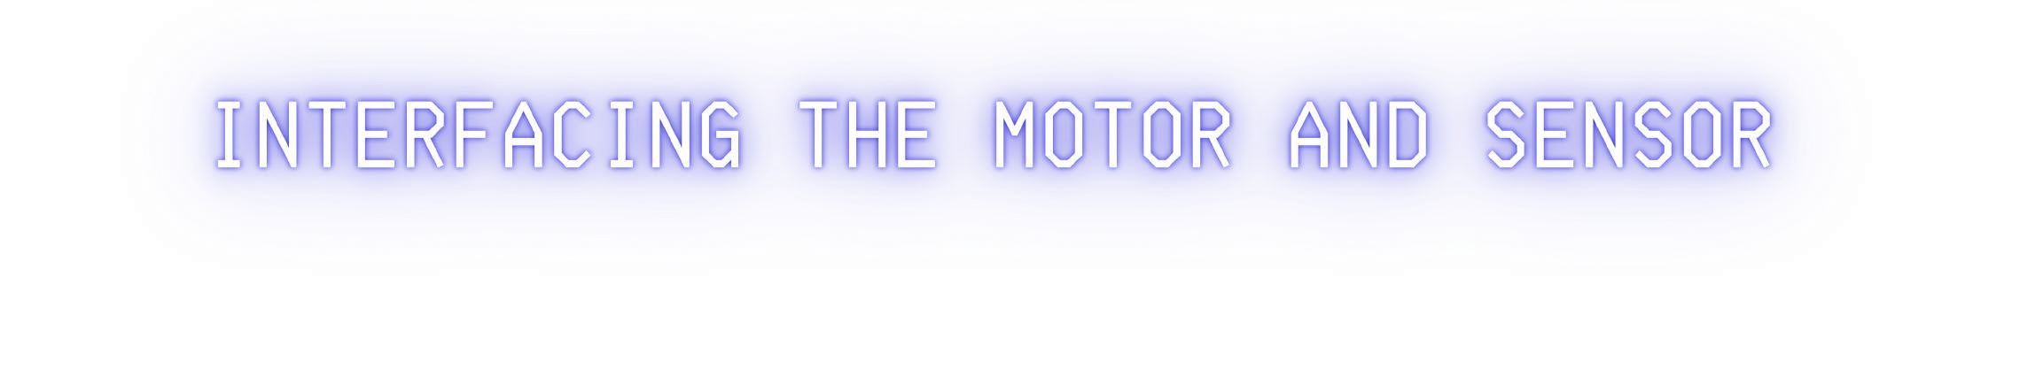
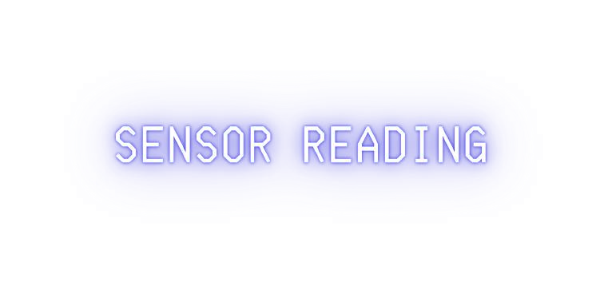




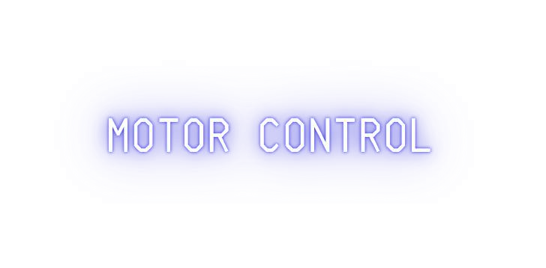




You read the values from the left and right sensors and print them to the serial monitor. These readings will be either 0 (black detected) or 1 (white detected).
r program then checks the sensor readings to determine what the robot should do:
If both sensors see black (0), it means the robot is directly over the line. In this case, all four motors are set to move forward at a speed of 150.
If the left sensor sees black and the right sensor sees white (1), the robot turns left by driving motors 1 and 2 forward and motors 3 and 4 backward, all at a higher speed of 200.
If the right sensor sees black and the left sensor sees white, the robot turns right in a similar way.
If neither sensor sees black, it means the robot has lost the line. In this case, all motors are set to RELEASE, effectively stopping the robot

Slide 6


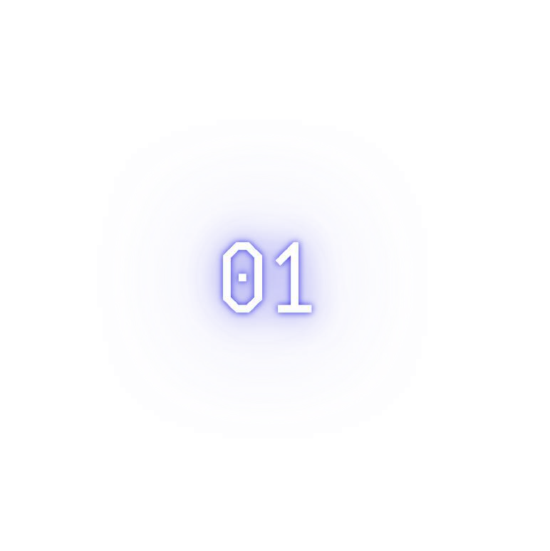
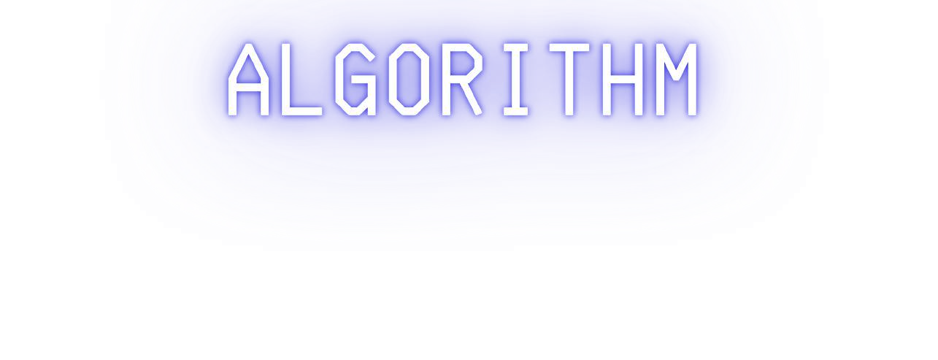
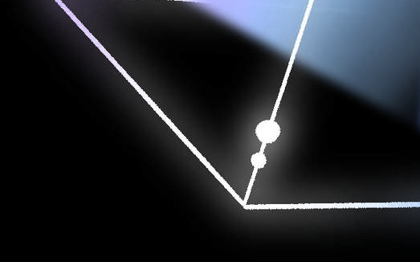




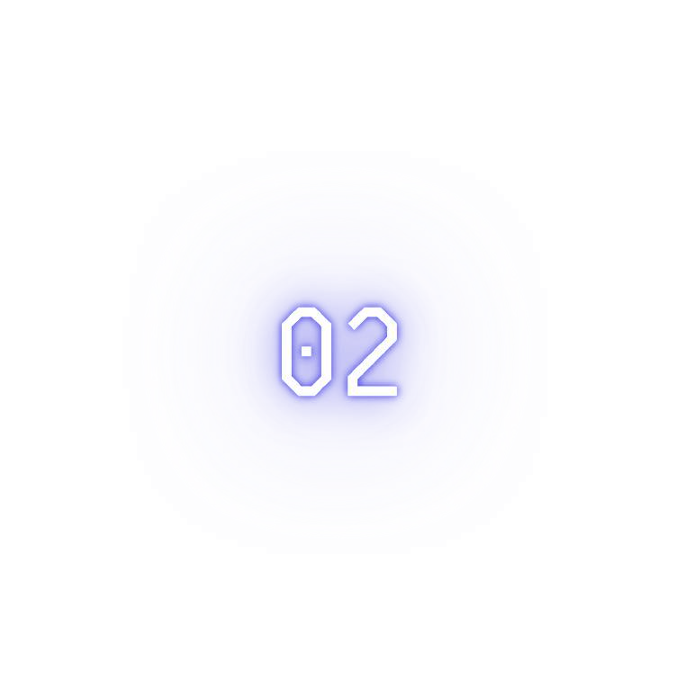






The core of a line follower robot is its control algorithm. This algorithm processes the input from the IR sensors and uses it to control the motors to keep the robot following the line. The general idea is
If the robot is centered on the line (both sensors see the same amount of black and white), it moves forward.
If the left sensor detects more black (meaning it's off the line to the right), the robot should turn right.
If the right sensor detects more black (meaning it's off the line to the left), the robot should turn left.

Slide 7
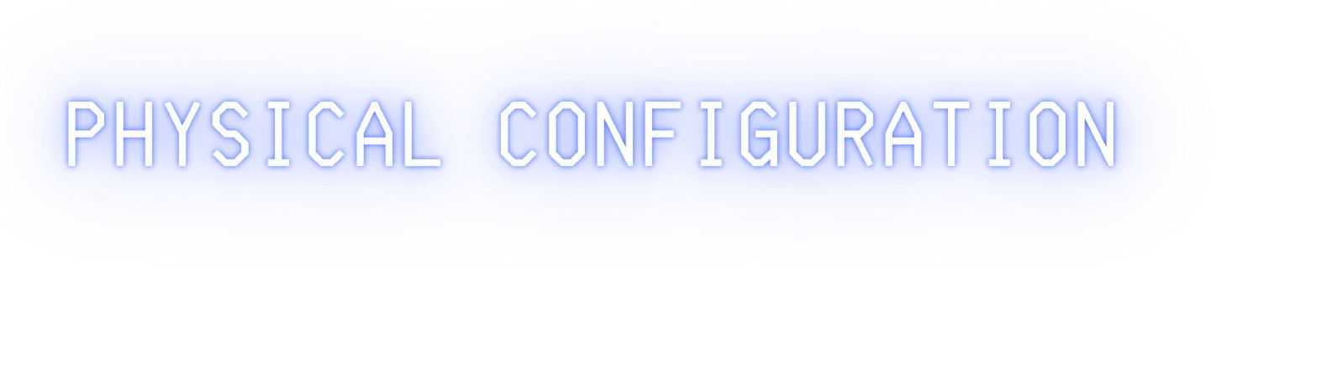











Chassis: A 4-wheel drive (4WD) car chassis with dimensions of 25.3cm (length) and 15cm (width) was used as the base. The chassis provides a stable platform for mounting all components.
Motors: Four DC motors were employed for propulsion. Motor1 and Motor2 are designated for forward movement, while Motor3 and Motor4 facilitate backward movement. Each motor is individually controlled to enable precise control over the robot's direction.
Sensors: Two IR sensors, labeled as 'left' and 'right', are placed at the front of the chassis. These sensors play a pivotal role in line detection, providing input to guide the robot's movements.
Batteries: Power is supplied by a 4-cell AA battery pack. This configuration ensures a steady and reliable source of energy for the motors and microcontroller.
Wheel Arrangement:
The robot is equipped with four wheels, each having a diameter of 6cm. This configuration provides the necessary traction and stability for smooth movement along the specified path.

Slide 8
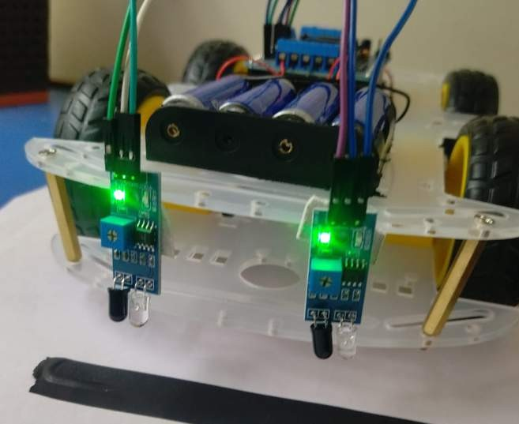
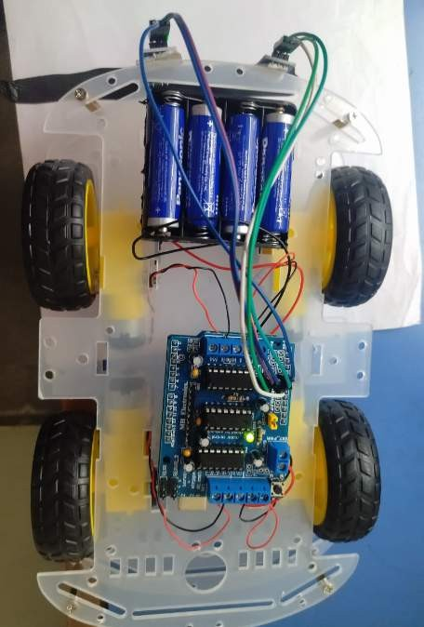

Slide 9



05
02
2nd October
PERFORMING THE
04
3rd november
06
10TH november
07
20th november
01
29th September
03
1ST november MOUNTING OF THE
4th november to 10th
WE PREPARED THE CODE AND LOGIC ACCORDING TO
november
USING PID ALGORITHM TO
UNDERSTANDING AND STUDY OF THE PROJECT
HARDWARE
OPTIMIZE THE PERFORMANCE
FINAL PRODUCT
SIMULATION ON PROTEUS
TROBLESHOOTING
HARDWARE

